Slide 1
COS70006
OOP
Unit Testing
Notes:
SDJ Lecture 5: Objects Intro pt2
© Swinburne or © Pearson Education, IncA Bayley
A Bayley

Slide 2
Learning Objectives
Students understand the why applications are tested
Students understand the concept of unit testing
Students can write unit tests in Java using Junit for individual code blocks

Slide 3
Why do we test code?
Writing syntactically and logically correct programs is difficult
  Beginners deal with a lot of syntax errors
  Experienced programmers deal with logical errors
Syntax errors
  Programs doesn’t compile and run successfully; hence easy to detect
  Can also avoid with the support of IDEs/ tools
Logical errors
  Program compiles and executes without an error but gives the wrong result
  Difficult to detect

Slide 4
Testing and Debugging
Testing
  is the process of checking if an application/ or part of code contains any errors
  ensuring the application meets the expected requirements
Debugging
  comes after testing. If tests have shown that an error is present, we use debugging
  is the technique to find out exactly where the error is and how to fix it

Slide 5
Unit Testing
Testing a distinct unit of functionality
Testable unit of functionality is not directly dependent of another unit of functionality
Unit tests are the finest level of granularity in testing
Can be done manually and can be automated as well
In a Java application;
  A single unit is often (but not always) a single method
Java unit testing frameworks
  JUnit (open source)
  http://junit.org/
Notes:
SDJ Lecture 5: Objects Intro pt2
© Swinburne or © Pearson Education, IncA Bayley

Slide 6
JUnit
Is a unit testing framework for Java
Promotes the idea of test driven development
Uses annotations to identify test methods
Provides assertions for testing expected results.
Provides test runners for running tests.
Test suits can be created including several test cases.
Can be automated or manually tested
Simple, less complex and takes less time
Notes:
It uses the approach:: code a unit->test->code a unit->test.
SDJ Lecture 5: Objects Intro pt2
© Swinburne or © Pearson Education, IncA Bayley

Slide 7
JUnit Test Framework
Fixures
  Fixed state of a set of objects involved in the test
  Provides a baseline for running a test
  setUp() - runs before every test invocation.
  tearDown() - runs after every test method.
JUnit classes
  E.g:
    Assert − Contains a set of assert methods

Slide 8
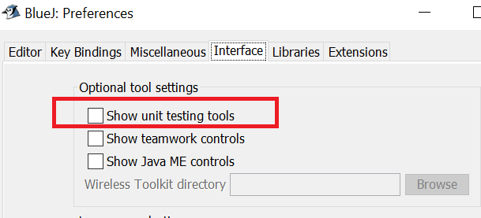
Setting up BlueJ for unit testing
Go to
  Tools > Preferences > Interface

Slide 9
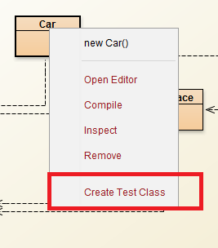
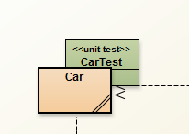
Adding a new test class
Right click on the class

Slide 10
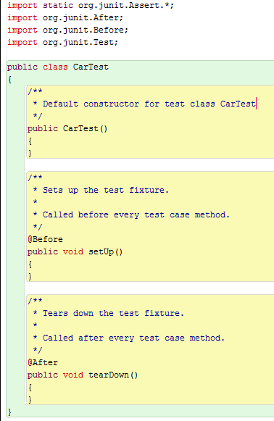
The test class
Notes:
SDJ Lecture 5: Objects Intro pt2
© Swinburne or © Pearson Education, IncA Bayley

Slide 11
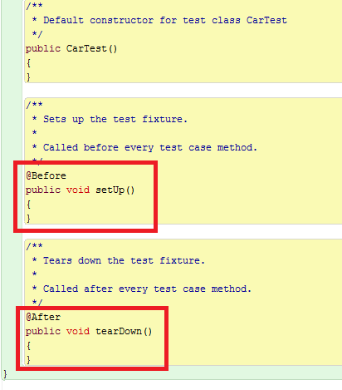
The test class
Fixtures
Provides a baseline for running a test
setUp() - runs before every test invocation.
tearDown() - runs after every test method.
Notes:
Fixtures is a fixed state of a set of objects used as a baseline for running tests.
These methods can be used directly: Assert.assertEquals(...), however, they read better if they are referenced through static import.
import static org.junit.Assert.*;
SDJ Lecture 5: Objects Intro pt2
© Swinburne or © Pearson Education, IncA Bayley

Slide 12
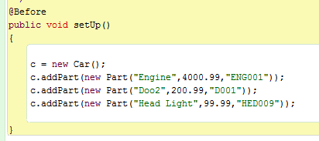
Example: Car Parts scenario
Setup method
Notes:
private Car c;
---------------
c = new Car();
c.addPart(new Part("Engine",4000.99,"ENG001"));
c.addPart(new Part("Doo2",200.99,"D001"));
c.addPart(new Part("Head Light",99.99,"HED009"));
SDJ Lecture 5: Objects Intro pt2
© Swinburne or © Pearson Education, IncA Bayley

Slide 13
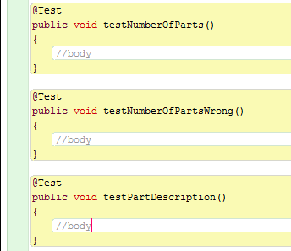
Example: Car Parts scenario
Writing a test method
should be annotated with @Test
Tells JUnit that this method can be run as a test case

Slide 14
Assertions
Assert is a class in the JUnit package
Assert class provides a set of assertion methods
Useful for writing tests
Only failed assertions are recorded
Some useful methods:
  assertEquals() – checks if two primitives/ objects are equal
  assertTrue() – checks if a condition is true
  Fail() – fails a test
For more details refer:
  http://junit.org/junit4/javadoc/latest/org/junit/Assert.html

Slide 15
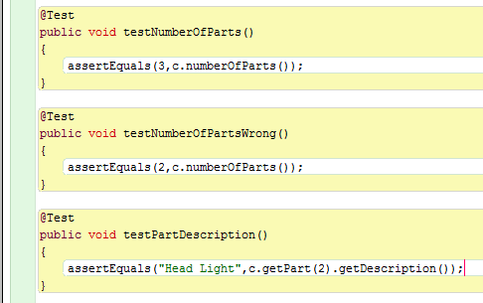
Example: Car Parts scenario
Using assertEquals() in Assert class

Slide 16
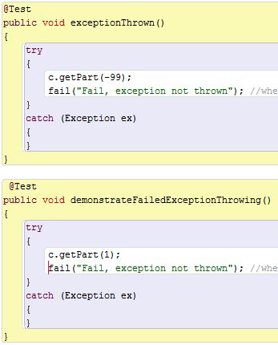
Example: Car Parts scenario
Exception test: using fail()
fail(String message) - Fails a test with the given message.
When it reaches this line, it causes the test case to fail.

Slide 17
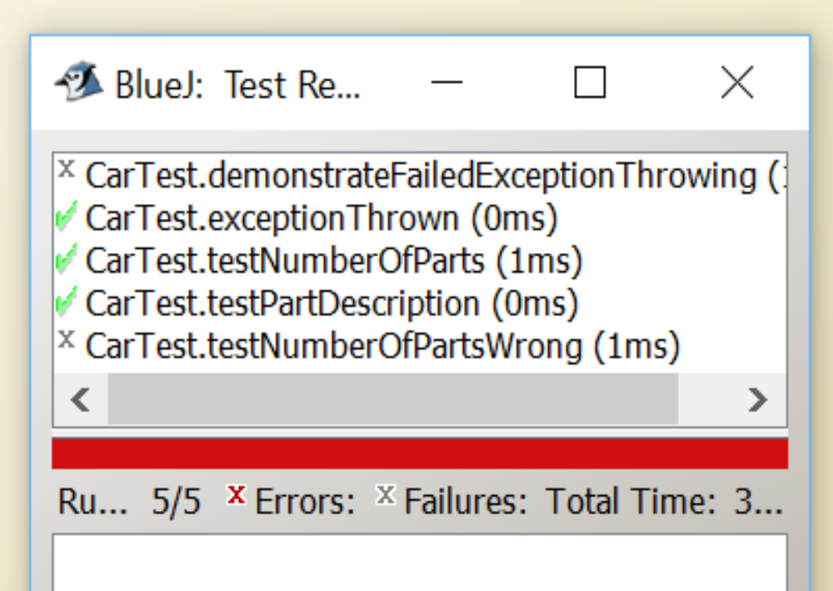
Example: Car Parts scenario
Test results

